Slide 1
Harnessing the Power of Big Data: Innovative Analytics Techniques for Enhanced Decision-Making
Author: Shreya Bhattacharjee
College: Pillai college of science and commerce
Contact Details: 91-7208319957

Slide 2

Introduction
Research Objective:
The study aims to investigate the impact of Big Data Analytics (BDA) on improving decision-making and operational efficiency across various industries. It explores key challenges and proposes strategies for organizations to harness the full potential of BDA.
Context:
With the explosion of data from sources like IoT, social media, and digital transactions, BDA has become essential in analyzing large datasets to derive insights, optimize processes, and forecast trends. Its application spans sectors like healthcare, finance, and education.
Research Questions:
How can BDA improve decision-making in industries?
What challenges do organizations face in adopting BDA?
What are the most effective tools and techniques for analyzing Big Data?
How can organizations address privacy and security concerns while using Big Data?

Slide 3

Literature Review
Key Theories/Models:
Big Data Analytics: Research heavily emphasizes advanced analytics methods like data mining, machine learning, predictive analytics, and real-time analytics. Each method provides significant value in various domains such as fraud detection, customer segmentation, and predictive maintenance.
Big Data's Impact on Decision Making: Studies, such as those by Wamba et al. (2015), discuss how big data improves decision-making by providing real-time insights into operations, customer behavior, and marketing strategies.
Gaps Identified:
Data Privacy and Security: Multiple studies identify the challenges associated with data privacy, security, and the lack of skilled data scientists to manage and analyze big data effectively.
Integration Challenges: Another gap highlighted is the difficulty in integrating big data systems with traditional IT infrastructures, as discussed by researchers like Kaisler et al. (2013).

Slide 4

Methodology
Research Design:
The research follows a qualitative approach, utilizing case studies to explore the application and impact of Big Data Analytics across various industries such as healthcare, finance, and education.
Data Collection:
Data was collected through surveys and interviews with industry experts, and secondary sources such as industry reports and academic journals on Big Data implementations.
Analysis Approach:
The collected data was analyzed using a thematic analysis approach to identify patterns, challenges, and opportunities for Big Data adoption. Insights were derived by comparing the case studies and evaluating the effectiveness of different Big Data tools and technologies.
This structure gives a clear and brief explanation of the methodology used in your research paper.

Slide 5
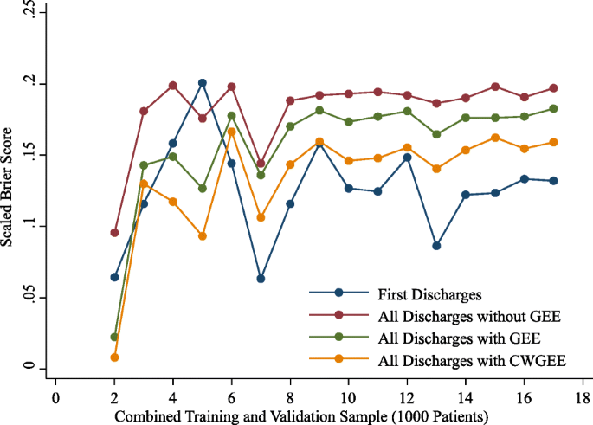
Findings
Increased Efficiency through Big Data Adoption: Big Data Analytics (BDA) has significantly enhanced operational efficiency in industries like healthcare, manufacturing, and banking. Organizations that adopt BDA report better decision-making, improved productivity, and cost savings.
Supporting Data:
Healthcare Sector: Hospitals implementing BDA saw a 20% reduction in patient readmission rates.
Manufacturing: Companies using predictive maintenance based on BDA reduced downtime by 30%.
Banking: Financial institutions leveraging BDA for fraud detection reduced fraudulent activities by 40%.

Slide 6
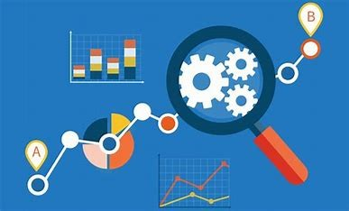
Challenges and Considerations
Data Privacy and Security:
Safeguarding Sensitive Data: Protect personal and financial information to avoid breaches and comply with regulations like GDPR and HIPAA.
Risk Management: Implement encryption and access controls to secure data and maintain trust.
Data Quality:
Importance: Accurate, clean data is crucial for reliable analytics and decision-making.
Data Cleansing: Regularly verify and clean data to avoid errors and inconsistencies.
Skill Gaps:
Professional Expertise: Data scientists and analysts are needed for accurate analysis and insights.
Skills Required: Proficiency in statistical analysis, machine learning, and data visualization is essential.
Training: Invest in ongoing training and development to address skill shortages.

Slide 7
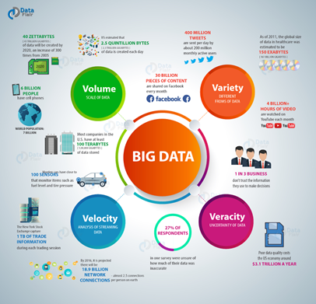
Future Trends
Augmented Analytics:
Definition: AI and machine learning enhance data analysis by automating preparation, analysis, and insight generation.
Automated Data Preparation: AI tools clean and organize data efficiently, reducing manual effort.
Enhanced Insights: AI identifies patterns and trends, including from unstructured data using NLP.
Self-Service Analytics: User-friendly tools enable non-technical users to generate insights independently.
Predictive & Prescriptive Analytics: AI predicts trends and recommends actions for informed decision-making.
Ethical Considerations:
Data Privacy: Comply with privacy laws and anonymize data to protect personal information.
Bias and Fairness: Regularly audit algorithms to avoid discrimination and ensure fairness.
Transparency: Clearly communicate how data is collected, used, and analyzed.
Accountability: Define responsibility for data governance and ethical practices.
Sustainability: Implement practices to reduce environmental impact and promote sustainable data management.

Slide 8

Conclusion
Big data analytics can drive innovation and growth by revealing patterns, optimizing operations, and personalizing customer experiences. However, challenges like data security, privacy, and regulatory compliance must be carefully managed. Investing in infrastructure, skilled talent, and strong data governance is essential. Organizations that address these challenges effectively will be well-positioned to thrive in a data-driven world.

